Slide 1

dbt for Beginners
A modern approach to data transformation

Slide 2

dbt for Beginners: A Modern Approach to Data Transformation
Presented by Eric Bragas, Sr.
Eric Bragas, Sr. first met SQL Server during the SQL 7 era—back when Y2K was a real concern and backups involved actual tapes. It was the start of a long, meaningful relationship built on F5, temp tables, and just the right amount of indexing. But over time, Eric’s heart drifted to the cloud. Now he's embracing dbt and modern data workflows—not because SQL Server broke his heart, but because he’s chasing something a little more... scalable.
Slide deck and demo dbt project: github.com/SQLLead/dbt_for_beginners
Contact Eric for questions, advice, or service at linkedin.com/in/ericbragas/

Slide 3

What is dbt?
dbt = “Data Build Tool”
“T” in ELT (Extraction => Load => Transformation)
Like SSIS for the cloud—but with Git, tests, docs, and SQL at the core
Uses SQL (or Python) to build models
Uses Jinja within SQL for logic, macros, and variables
Automatically tracks dependencies
…and why should I care?
Old Way in SQL Server | dbt Equivalent
Manually building & tracking views | Modular SQL files with automatic DAGs
SSIS packages or job steps | One-line dbt run + full dependency graph
Writing inline docs or spreadsheets | Auto-generated docs with column descriptions
Maintaining logic in stored procs | Declarative SQL files + test coverage
Scheduled Agent jobs | GitHub Actions or dbt Cloud Jobs
Code reviews by diffing .sql files manually | Git versioning, PR reviews, CI

Slide 4
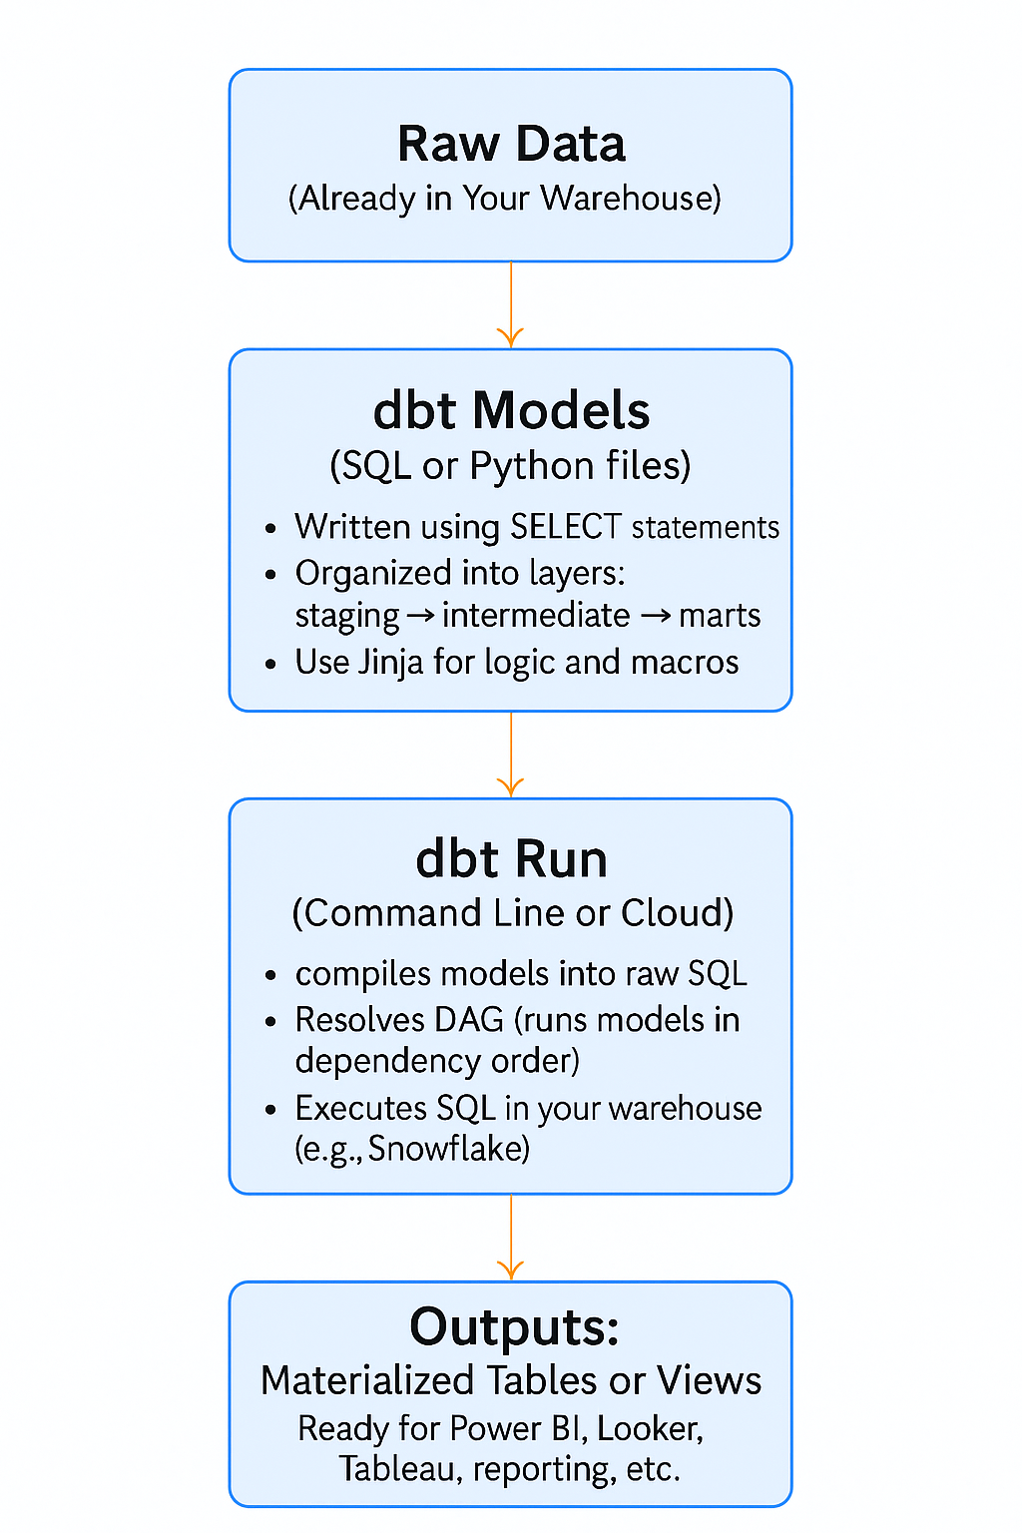
How Does dbt Work?
dbt is a command-line tool (or Cloud service) that reads your project files — mostly .sql models and .yml configs — and uses that to generate and run SQL inside your data warehouse.
Reads .yml files to understand your sources, tests, model settings, and documentation.
Reads your .sql and .py models to determine what objects to build and how they depend on each other.
Builds a DAG (dependency graph) of models, based on how they reference each other using {{ ref() }}.
Compiles the SQL using Jinja (like a template engine).
Executes that SQL in the warehouse (e.g., Snowflake), creating tables/views in the correct order.
Notes:
Imagine a Python program that opens every sql file in your folder, figures out what views or tables you want, builds a dependency chain based on how they reference each other, and then runs them in order in your database — while also testing them and documenting them along the way.
dbt doesn't run inside the database — it tells the database what to do, based on your code.

Slide 5
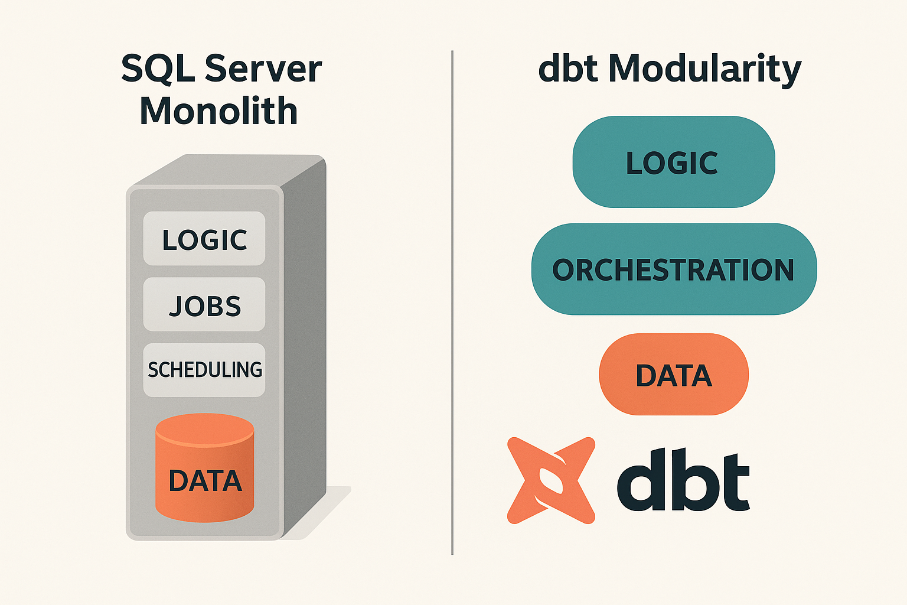
From SQL Server Monolith to dbt Modularity
SQL Server: logic, data, jobs, and scheduling all in one place
dbt: logic and orchestration live in code outside the database
Notes:
Dbt separates the logic from the platform. How difficult would it be to change your EDW platform from SQL Server to AWS or Snowflake?

Slide 6
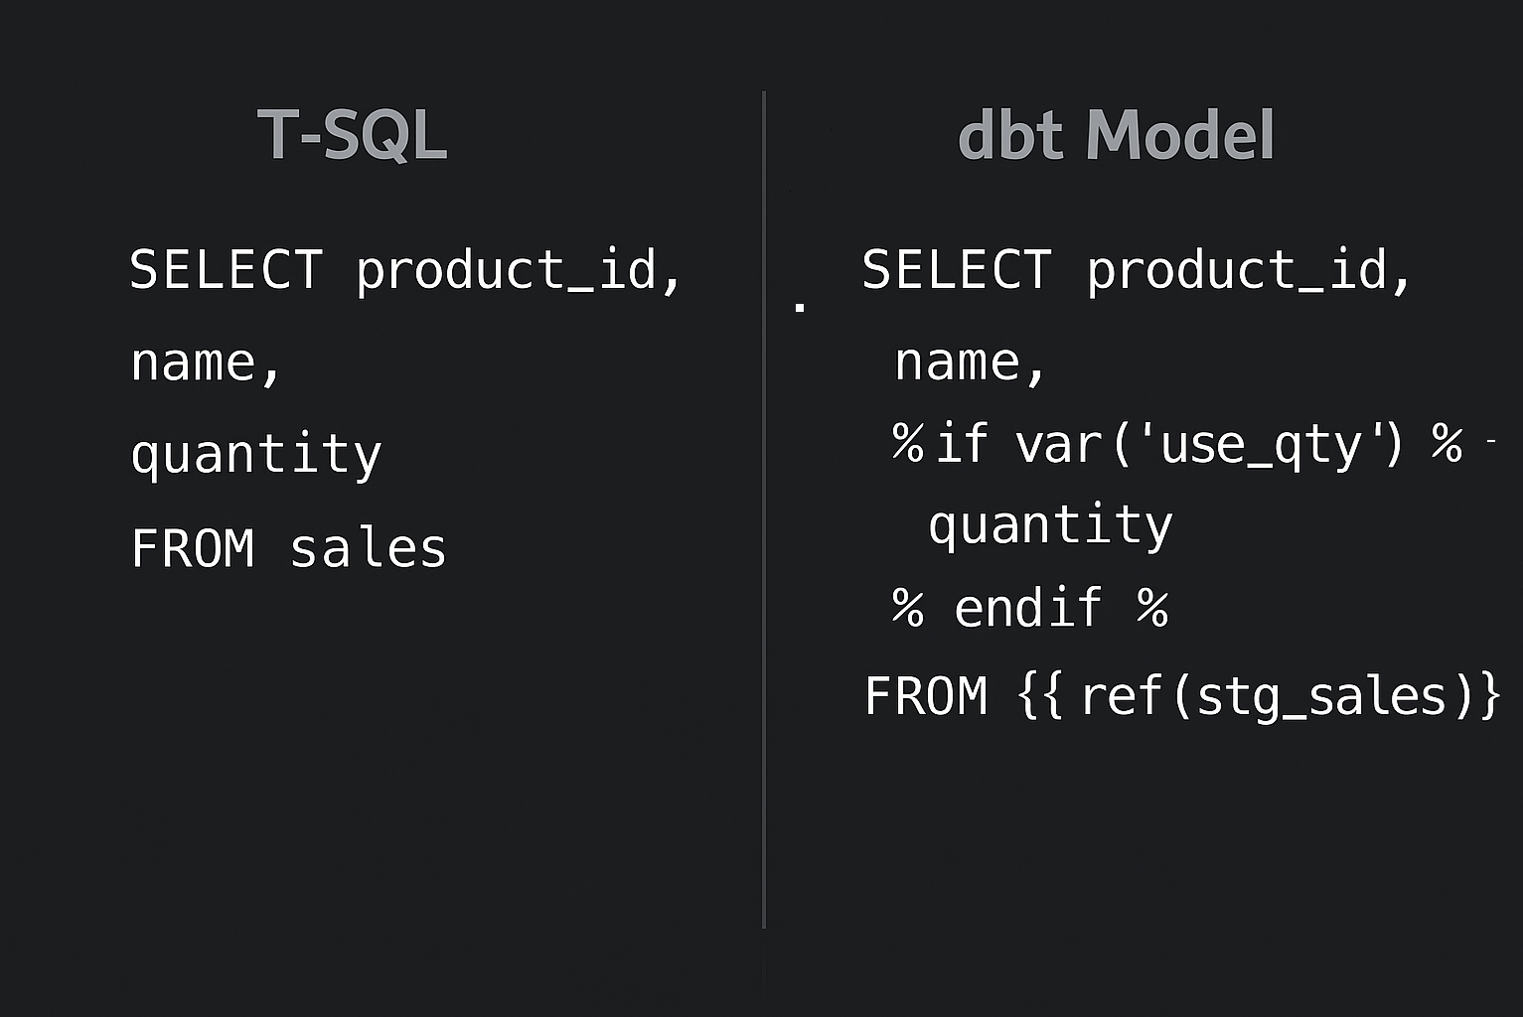
How dbt Uses SQL Differently
You only write SELECT statements (no DML or DDL)
dbt materializes the result as a view or table
Models can reference each other using {{ ref() }} and sources using {{ source() }}
It’s set-based transformation with repeatable outcomes

Slide 7
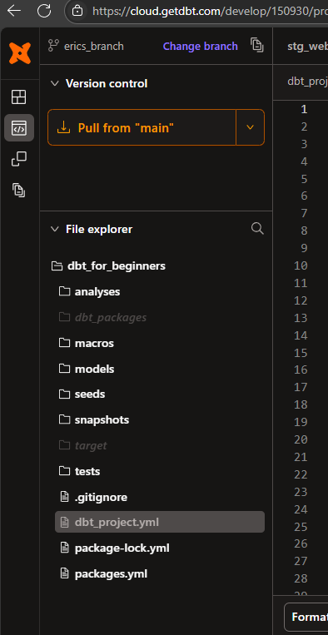
Project Anatomy: What’s in a dbt Project?
analyses/ - SQL files for manual execution only
dbt_packages/ - imported functionality
macros/ - Jinja-based logic helpers (like SQL functions)
models/ - SQL and PY queries
seeds/ - small flat files for source usage
snapshots/ - SCD changes
target/ - compiled SQL
tests/ - (guess!)
dbt_project.yml - the project’s global config
packages.yml – packages to import for functionality

Slide 8
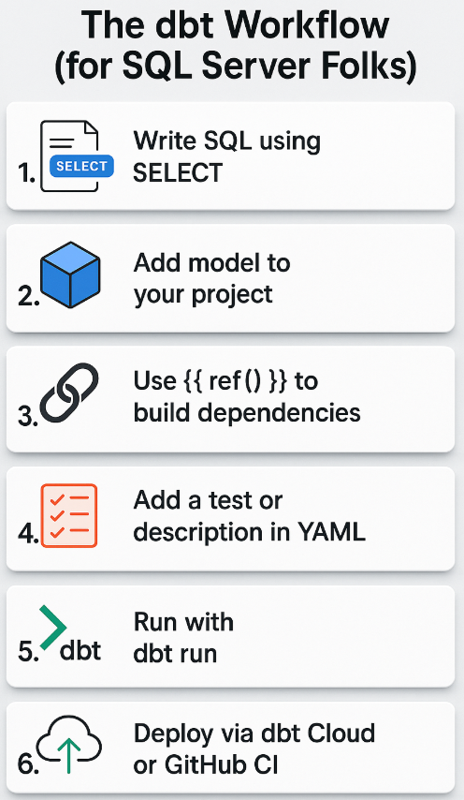
The dbt Workflow (for SQL Server Folks)

Slide 9

Key Concepts You Don’t Know Yet
ChatGPT says…
Eric says…
ref() = safe way to refer to other models
Jinja = templating layer inside SQL
Materializations: table, view, incremental
built in tests: simple YAML checks for quality
dbt Docs: auto-generated lineage + descriptions
A mind shift is necessary! Forget about coding:
inserts, updates, deletes, drops, merges, temp tables, etc.
Stored procedures
checkpoints, job dependencies, create objects…
And think about:
just the SELECT query
using more CTE’s than ever previously imagined
what constitutes truly “dynamic” SQL
lowercase everything

Slide 10
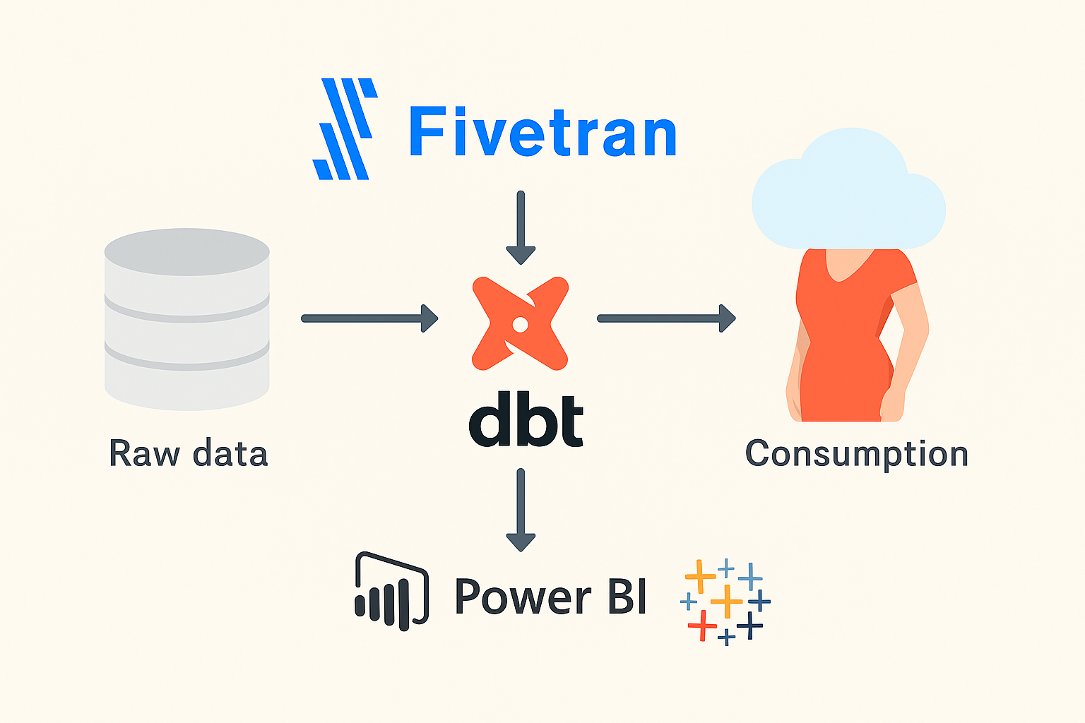
How dbt Fits into a Modern Stack
…this is just one example!

Slide 11
SQL Server vs dbt: What Carries Over?
What You Know:
In dbt, they are:
T-SQL SELECTs
CTEs, joins
Views, tables
Stored Procs
SQL Agent Jobs
Inline comments
dbt SQL models
Same
Controlled with config.
Replaced by modular models
Replaced by dbt Cloud jobs or GitHub Actions
Same, plus YAML doc blocks

Slide 12
General dbt Commands
cli Command | Result
dbt run dbt run --select [model_name] | Runs all models and materializes the results Runs and materializes a specific model
dbt docs generate | Compiles documentation
dbt test | Runs all tests
dbt compile | Compiles all SQL statements to “Target” folder
dbt seed | Loads local file(s), aka “seeds”
dbt snapshot | Tracks and records changes to SCD’s
dbt retry | Retries nodes that failed in the last run
dbt build | compile + seed + run + snapshot + test
dbt debug | Confirms dbt install, project structure, EDW connection, and required settings
dbt deps | Downloads and installs packages, makes avail.

Slide 13

Get On With the Demo!!!
Snowflake source tables:
Customers
Sales Order Headers
Sales Order Details
Local seed files:
Sales Regions (determined by zip code)
(3) web logs (for append-only table)
Objects not yet materialized
Demo steps:
Import seed files
Process models (note the execution order)
Generate documentation, view DAG
Test it (built-in and custom)
Cause a test failure, then fix it
customer_state can’t be unique
A Contrived dbt Project for Demonstration Purposes That Makes Little Overall Sense, So Don’t Overanalyze It

Slide 14
Uhhh…What Just Happened?
dbt read all the YML files, compiled the SQL
Models were materialized based on YML spec
stg_web_logs materializes as a view, as does stg_sales_regions
Objects were [re-]created and the source queries were executed
Built-in and custom tests were executed
A dbt macro resembling a T-SQL function was created and used without being saved anywhere
Execution order was dictated by {{ ref() }} and {{ source() }} Jinja tags
Also used for determining the DAG and how potential parallelism is determined

Slide 15
More dbt
dbt_project.yml
schema.yml
fct_web_activity – incremental materialization
Analyses: in the DAG but not models
Python model: dim_web_user_behavior
Panda’s built in!
dbt Cloud:
preview, compile, build, format
DAG
Packages: db_utils (seriously, don’t write your own)
dbt deps downloads and installs dbt packages, makes available to your project

Slide 16
dbt Project Tests and Macros
macros/tests/test_zip_code_validity.sql
reusable test logic
tests/test_total_amount_check.sql
Custom data test/quality check
Not reusable
One or more result rows constitutes a failure
Macros/is_high_value_order.sql
Only runs when called inside dbt code
Acts like a function—can be very useful for testing
ex: dim_sales_order_headers
Custom tests can be called ad-hoc with: dbt test [custom_test_name]

Slide 17
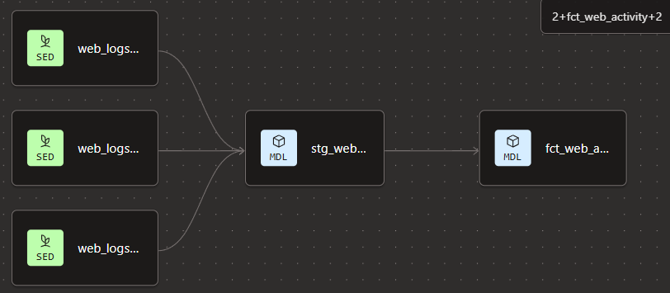
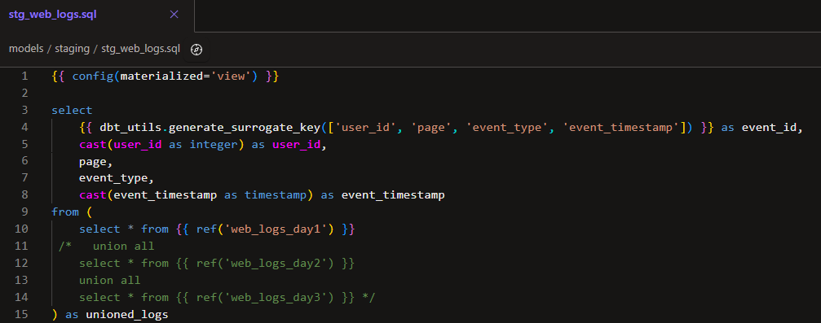
Appending New Data
Do not rebuild fct_web_activity on execution
Change stg_web_activity to mimic daily activity
Execute fct_web_activity and dependencies:
dbt run --select +fct_web_activity
Model review: fct_web_activity

Slide 18
Jinja Examples
{% set column_name = 'customer_id' %}
{% set table_name = ref('raw_customers') %}
select
{{ column_name }},
first_name,
last_name
from {{ table_name }}
select
{% for col in ['customer_id', 'first_name', 'last_name'] %}
{{ col }}{% if not loop.last %}, {% endif %}
{% endfor %}
from {{ ref(‘stg_customers') }}
macros/select_customer_columns.sql
models/use_macro.sql
{% macro select_customer_columns() %}
customer_id,
first_name,
last_name
{% endmacro %}
select
{{ select_customer_columns() }}
from {{ ref('raw_customers') }}

Slide 19
What Else Should I Know?
dbt is entirely CI/CD capable
dbt Cloud has jobs and a scheduler (or Airflow?)
“dbt Core” is a local install of dbt, runs locally
The DAG is a highly useful tool and has cool viewing functions that can be applied to executions, testing, and more
dbt “snapshots” are used for SCD’s (not demo’d)
dbt cte alias’s have a naming convention
dbt is platform agnostic! Changing from Snowflake to GCP requires no code changes and only a single configuration.
dbt can materialize any EDW, er, “model” such as Kimball, Inmon, DataVault, etc.
unit testing available (not shown)
Tests called with dbt build will be executed before the model itself is executed.

Slide 20

Thank you! Questions?
Resources
dbt videos: https://learn.getdbt.com/learn/dashboard
What is Jinja? https://pushmetrics.io/learn/jinja/what-is-jinja/
Quickstart for the dbt Cloud Layer with Snowflake
All learning was free! Try it!!!
Set up Snowflake 30-day trial
Sign up for dbt Cloud (no expiration!)
Eric loves helping people and loves “talking shop!” Call on me* for advice, assistance with dbt-to-Snowflake configuration, SQL Server, or a hair-brained, half-baked idea!
* For really difficult questions, lob them over to Eric Bragas, Jr., he loves that kind of stuff. ☺

Slide 21


